Slide 1
Clustering Analysis
Md. Jakaria
Lecturer
Dept of Computer Science & Engineering
Military Institute of Science and Technology

Slide 2
What is Cluster Analysis?
Finding groups of objects such that the objects in a group will be similar (or related) to one another and different from (or unrelated to) the objects in other groups
Inter-cluster distances are maximized
Intra-cluster distances are minimized

Slide 3
Applications
Understanding
Biological taxonomy
Group related documents for browsing
Group genes and proteins that have similar functionality
Group stocks with similar price fluctuations
Summarization
Reduce the size of large data sets
Compression
Vector quantization
Finding nearest neighbor

Slide 4
Applications .. .
Hypothesis generation
To infer some hypothesis
Hypothesis testing
To verify an existing hypothesis
Example: ‘big companies invest overseas’
Prediction based on groups
Predict unknown patterns

Slide 5
What is not Cluster Analysis?
Supervised classification
Have class label information
Simple segmentation
Dividing students into different registration groups alphabetically, by last name
Results of a query
Groupings are a result of an external specification

Slide 6
Clustering Basis
Basic Concepts
a clustering criterion must first be adopted.
Different criteria lead to different clusters.

Slide 7
Notion of a Cluster can be Ambiguous
Depending on the similarity measure, the clustering criterion and the clustering algorithm, different clusters may result. Subjectivity is a reality to live with from now on.

Slide 8
Notion of a Cluster can be Ambiguous
Depending on the similarity measure, the clustering criterion and the clustering algorithm, different clusters may result. Subjectivity is a reality to live with from now on.
How many clusters?
Six Clusters
Two Clusters
Four Clusters

Slide 9
Notion of a Cluster can be Ambiguous
Let these animals to be clustered
Blue shark, sheep, cat, Dog, Lizard, sparrow, viper, seagull, gold fish, frog, red mullet

Slide 10
A real example
Blue shark,
sheep, cat,
dog
Lizard, sparrow, viper, seagull, gold fish, frog, red mullet
Two clusters
Clustering criterion: How mammals bear their progeny
Gold fish, red mullet, blue shark
Sheep, sparrow, dog, cat, seagull, lizard, frog, viper
Two clusters
Clustering criterion: Existence of lungs

Slide 11
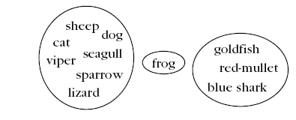
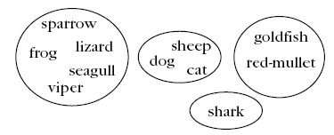
A real example
Three clusters
Clustering criterion: Their living
environment
Four clusters
Clustering criterion: Bear progeny and Existence of lungs

Slide 12
Clustering Task Stages
Feature Selection: Information rich features-Parsimony
Proximity Measure: This quantifies the term similar or dissimilar.
Clustering Criterion: This consists of a cost function or some type of rules.
Clustering Algorithm: This consists of the set of steps followed to reveal the structure, based on the similarity measure and the adopted criterion.
Validation of the results.
Interpretation of the results.

Slide 13
Clustering Definitions
Hard Clustering: Each point belongs to a single cluster
Fuzzy clustering: Each point belongs to all clusters up to some degree.
Probabilistic clustering (it is based on the probability of a point to belong to a cluster).

Slide 14
CLUSTERING ALGORITHMS
Number of possible clusterings
Let X={x₁,x₂,…,x_{N}}.
Question: In how many ways the N points can be
assigned into m groups?
Answer:

Slide 15
CLUSTERING ALGORITHMS
Number of possible clusterings
Let X={x₁,x₂,…,x_{N}}.
Question: In how many ways the N points can be
assigned into m groups?
Answer:
Examples:

Slide 16
CLUSTERING ALGORITHMS
Number of possible clusterings
Let X={x₁,x₂,…,x_{N}}.
Question: In how many ways the N points can be
assigned into m groups?
Answer:
Examples:

Slide 17
CLUSTERING ALGORITHMS
Number of possible clusterings
Let X={x₁,x₂,…,x_{N}}.
Question: In how many ways the N points can be
assigned into m groups?
Answer:
Examples:

Slide 18
A way out:
Consider only a small fraction of clusterings of X and select a “sensible” clustering among them.
Question 1: Which fraction of clusterings is considered?
Question 2: What “sensible” means?
The answer depends on the specific clustering algorithm and the specific criteria to be adopted.

Slide 19
Clustering Algorithms
2 Important distinctions: hierarchical and partitional
Partitional Clustering
A division data objects into non-overlapping subsets (clusters) such that each data object is in exactly one subset
Hierarchical clustering
A set of nested clusters organized as a hierarchical tree

Slide 20
Partitional Clustering
Original Points
A Partitional Clustering

Slide 21
Hierarchical Clustering
Traditional Hierarchical Clustering
Traditional Dendrogram
Non-traditional Hierarchical Clustering
Non-traditional Dendrogram

Slide 22
k-means Clustering
Partitional clustering approach
Each cluster is associated with a centroid (center point)
Each point is assigned to the cluster with the closest centroid
Number of clusters, K, must be specified
The basic algorithm is very simple

Slide 23
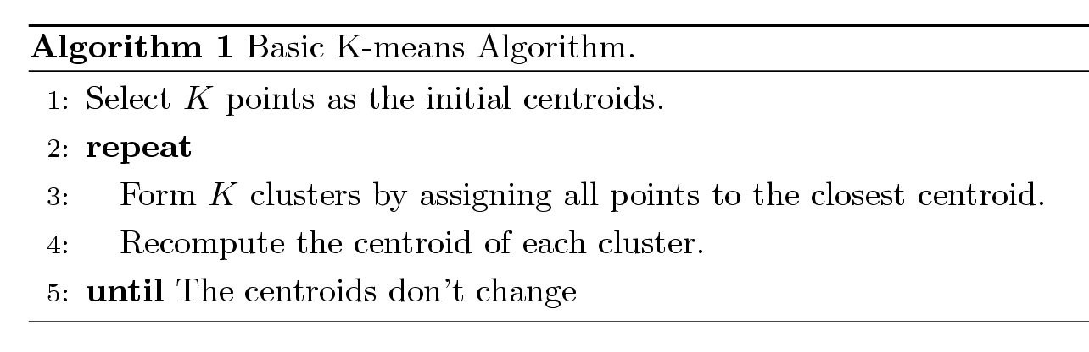
K-means Clustering
Partitional clustering approach
Each cluster is associated with a centroid (center point)
Each point is assigned to the cluster with the closest centroid
Number of clusters, K, must be specified
The basic algorithm is very simple

Slide 24
K-means Clustering
Initial centroids are often chosen randomly.
Clusters produced vary from one run to another.

Slide 25
K-means Clustering
Points are distributed to the closest centroid.
‘Closeness’ is measured by Euclidean distance, cosine similarity, correlation, etc.

Slide 26
K-means Clustering
centroid is (typically) the mean of the points in the cluster.

Slide 27
K-means Clustering
centroid is (typically) the mean of the points in the cluster.

Slide 28
K-means Clustering
K-means will converge for common similarity measures

Slide 29
K-means Clustering
Most of the convergence happens in the first few iterations.
Often the stopping condition is changed to ‘Until relatively few points change clusters’

Slide 30
K-means Clustering

Slide 31
K-means Clustering
k-means try to optimize an objective function

Slide 32
K-means Clustering
k-means try to optimize an objective function

Slide 33
Evaluating K-means Clusters
Given two clusters, choose the one with the smallest error
An easy way to reduce SSE is to increase K
A good clustering with smaller K can have a lower SSE than a poor clustering with higher K

Slide 34
K-means Clustering – Complexity
Storage Complexity is O ((m+K)n)
m = number of points
K = number of clusters
n = number of attributes
Time Complexity is O(I* K * m *n )
I = number of iterations

Slide 35
K-means may lead to suboptimal solution
Original Points
Optimal Clustering
Sub-optimal Clustering

Slide 36
Importance of Choosing Initial Centroids

Slide 37
Importance of Choosing Initial Centroids
find optimal SSE, although initial centroids are from one natural cluster

Slide 38
Importance of Choosing Initial Centroids …

Slide 39
Importance of Choosing Initial Centroids …
cannot find optimal SSE

Slide 40
Problems with Selecting Initial Points
If there are K ‘real’ clusters then the chance of selecting one centroid from each cluster is small.
Chance is relatively small when K is large
Consider an example of five pairs of clusters

Slide 41
10 Clusters Example
Starting with two initial centroids in one cluster of each pair of clusters

Slide 42
10 Clusters Example
Starting with two initial centroids in one cluster of each pair of clusters

Slide 43
10 Clusters Example
Starting with some pairs of clusters having three initial centroids, while other have only one.

Slide 44
10 Clusters Example
Starting with some pairs of clusters having three initial centroids, while other have only one.

Slide 45
Solutions to Initial Centroids Problem
Multiple runs
Helps, but probability is not on your side
Sample and use hierarchical clustering to determine initial centroids

Slide 46
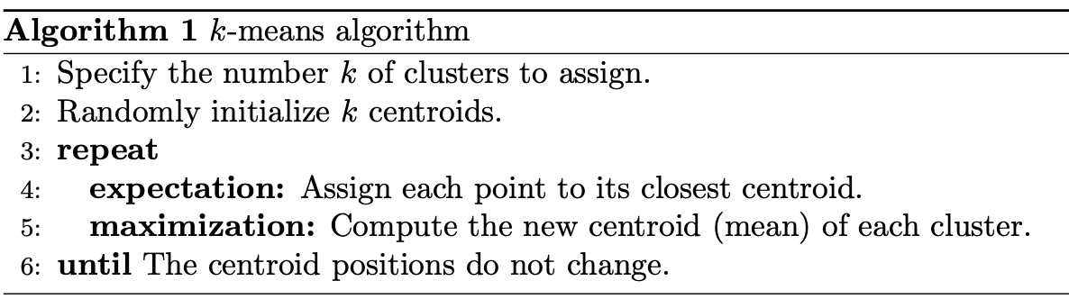
K-means Clustering

